Slide 1
The Emerging AI Regulatory Environment
Public Institutions

Slide 2
Context
Increasing pace of improvement in AI systems
50% of AI experts believe unaided machines will be able to do every task better and more cheaply than humans by 2061 or earlier; 90% within a century (Katja Grace et al. 2022)
Public Institutions

Slide 3
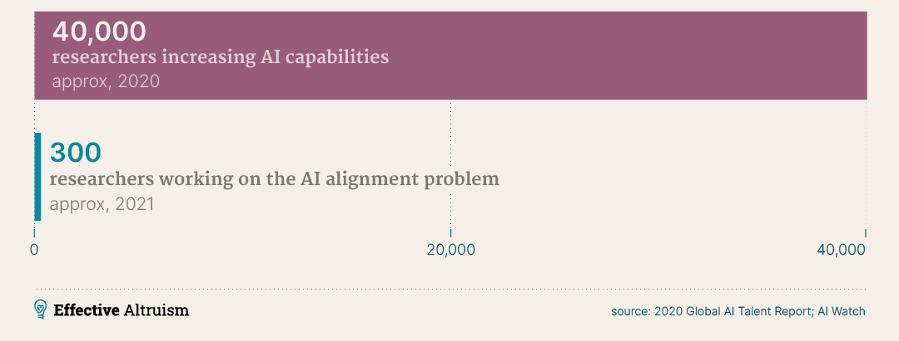
AI governance capacity significantly lags AI Engineering
Public Institutions

Slide 4
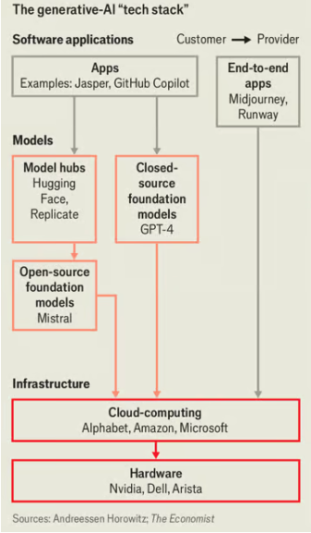
Policy Reactions
Need to approach each part of the “tech stack” individually: essentially i) infrastructure, ii) models, and iii) applications
Case Studies:
European Union
United States
India
Public Institutions

Slide 5
European Union
Existing legislation:
Digital Services Act (DSA)
Digital Markets Act (DMA)
General Data Protection Regulation (GDPR)
Implications for AI: model training, finetuning and applications
Public Institutions
Notes:
The DSA is more consumer protection-focused, while the DMA is more competition-focused.
The DSA aims to create a safer digital environment and change the balance of power between big platforms and users.
The DMA aims to limit the power of big tech monopolies and open up the digital market.
The GDPR governs how personal data can be processed and transferred. The GDPR is considered the strongest privacy and security law in the world. It is based on six core principles: Lawfulness, fairness, and transparency, Purpose limitation, Data minimization, Accuracy, Storage limitation, Integrity and confidentiality, Accountability.

Slide 6
European Union
AI Act (2024)
“Risk-Based” Approach
Focussed on application not models or infrastructure
Tech stack
Infrastructure: less emphasis but environmental impact noted
Models: governs data usage, transparency and governance processes
Applications: strong emphasis with scope to ban or fine applications for introducing risks and real harms
Public Institutions
Notes:
Key Components:
Risk-Based Approach: The AI Act classifies AI systems into four risk categories:
Unacceptable Risk: AI applications deemed to pose an unacceptable risk, such as social scoring systems, are outright banned.
High-Risk: AI systems used in critical areas like healthcare, employment, law enforcement, and education are subject to strict requirements. These include ensuring transparency, data quality, human oversight, and robustness.
Limited Risk: AI systems with specific transparency obligations (e.g., chatbots, deepfakes)
Minimal Risk: Most AI systems, like spam filters and AI-powered video games, fall under this category and face little regulation.
Enforcement: The AI Act will be enforced through significant fines for non-compliance, mirroring the approach of the GDPR (General Data Protection Regulation).
Goals of the AI Act:
Protecting Fundamental Rights: Guarantee the safety of AI systems and prevent discrimination or bias.
Boosting Trust: Ensure transparency, accountability, and human oversight, building user confidence.
Encouraging Innovation: Provide a clear regulatory framework to give businesses and developers the legal certainty needed to innovate with AI responsibly.
Global Leadership: Position the EU to set global standards for ethical AI development and deployment.

Slide 7
United States
Existing legislation:
Algorithmic Accountability Act (2022)
The Algorithmic Justice and Online Platform Transparency Act (2022)
The National Artificial Intelligence Act (2021)
Implications for AI: primarily applications
Public Institutions
Notes:
Algorithmic Accountability Act of 2022: This bill requires companies to conduct impact assessments for high-risk automated systems, including AI.
The Algorithmic Justice and Online Platform Transparency Act of 2022: Focuses on transparency and accountability of AI systems used by large online platforms.
The National Artificial Intelligence Act of 2021 A proposed framework for coordinating AI research, development, and standards across multiple federal agencies.

Slide 8
United States
Proposed legislation:
Currently evolving but no unified legislation in progress
Executive Order (2024) on AI
Tech stack
Infrastructure: strong emphasis on cloud computing infr. Reporting
Models: Defence Production Act used to compel companies to report testing results
Applications: less emphasis than EU AI Act
Public Institutions

Slide 9
India
Proposed legislation:
Draft legislation on AI capabilities
Tech stack
Infrastructure: minimal
Models: required all models to be registered and approved before deployment; considered the strictest proposal to date
Applications: less emphasis than EU AI Act or US drafts
Draft proposals dropped after consultation
Public Institutions

