Slide 1
Reinforcing AI and Digital Transformation Competencies in the public sector Ms. Marielza Oliveira, Director, Division for Digital Inclusion, Policies and Transformation, Communications and Information Sector, UNESCO

Slide 2
Digital Transformation challenges
Culture : Diversity of expression, inclusion
Social Human Sciences : Definition of ethical norms
Communication : Human Rights, access, journalism, digital transformation, competencies
Education: AI for teaching/learning, preparing the future of work
Science : Disaster risk reduction, climate change
Digital divides and inequalities
Protection of human rights online
Lack of transparency, accountability and openness
Technology changing faster than regulation
Uneven or weak capacities
Notes:
Source: COMEST, 2019 - https://unesdoc.unesco.org/ark:/48223/pf0000367823

Slide 3
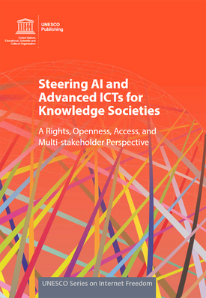
UNESCO’s Approach to Digital Transformation: ROAM-X
Human Rights-based
Openness in data, knowledge, markets and opportunities
Inclusive Access for digital transformation
Multi-stakeholder approach to digital governance
Cross-cutting Priorities: Gender equality, Africa​
Notes:
UNESCO's approach to AI can be summed up in the acronym "ROAM-X", which is elaborated in UNESCO's publication Steering AI and Advanced ICTs for Knowledge Societies.
We aim to 'steer’ clear of both technological utopianism, and dystopian thinking, instead giving attention to the role of human agency and human-centred values in the development of AI.
The ROAM-X values are:
Human Rights-based approach
Openness in AI: Knowledge, data, markets and opportunities
Inclusive Access for AI development
Multi-stakeholder approach for AI governance
Cross-cutting Issues: AI and gender X AI and Africa
These ROAM principles serve as a compass to ensure a human-centered technology.
Applying the ROAM Principles and Indicators at a national level helps to research, map and improve the ecosystem in which AI is developed, applied and governed.

Slide 4
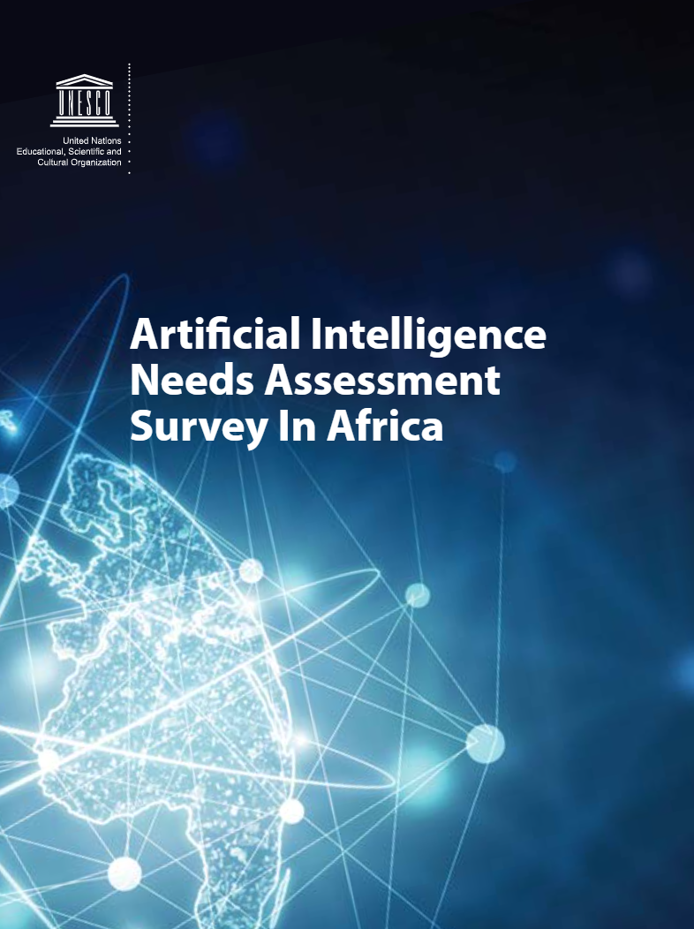
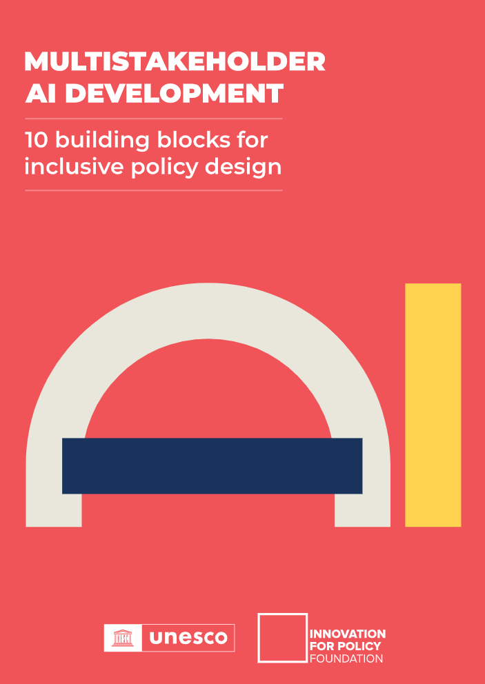
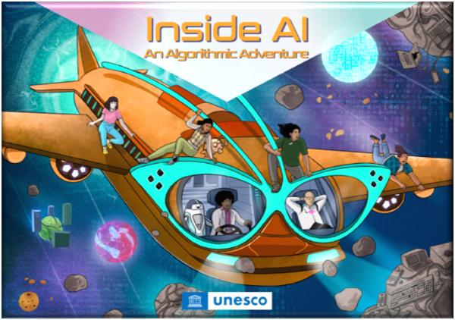
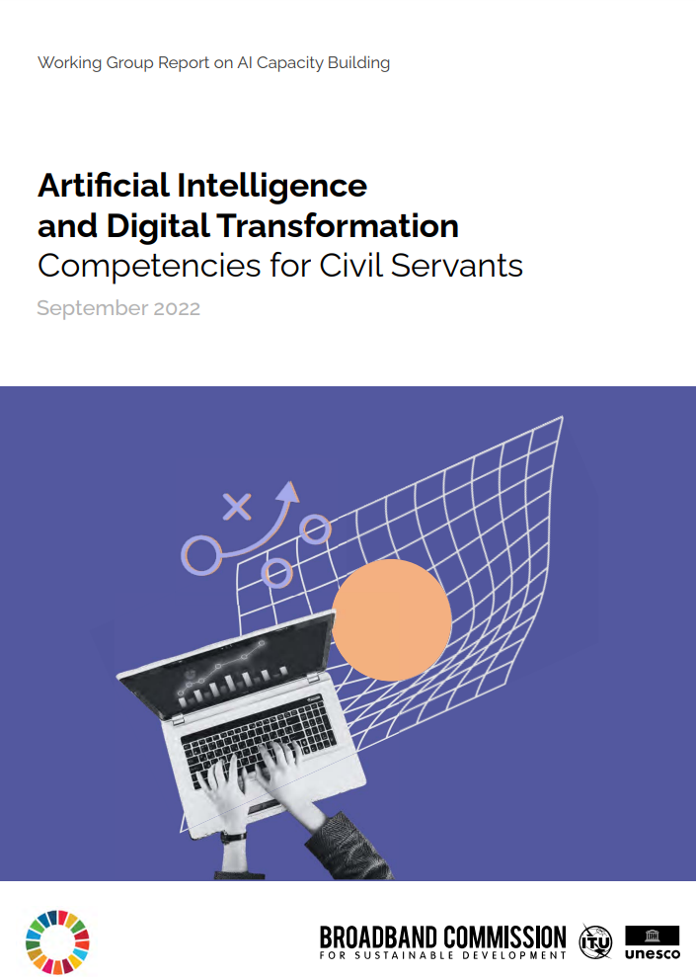
Capacity-building intervention cycle
Intervention Design
Implementation & Evaluation
Needs Assessment
Awareness Raising
Stakeholder Engagement
Notes:
How? Capacity Development Process
Stakeholder Engagement
Needs Assessment
Intervention Design
Implementation
Evaluation

Slide 5
Opportunities created by Digital Transformation
Public service delivery
Complex governance problems
Public engagement
Transparency and accountability
Notes:
Public Service Delivery
For example, digital transformation efforts in the State Court of Justice in Sao Paulo, Brazil, which included the deployment of a digital solution and training of 50,000 employees, has accelerated the processing time of new cases by 87% – people now only require two minutes to register their information (as compared to 21 minutes before the digital deployment).
Similarly, citizens in Grand Rapids, Michigan, United States, are now able to access most information across public utilities departments with a call to one single number, or a visit to the website through a new customer relationship management process and analysis tool, saving US$1 million in the first 18 months.
In recent years, Ukraine has heavily invested in the digital transformation of its public sector. This work has been channeled into the development of the Diia app, which gives Ukrainians access to twelve services and nine digital documents, including an ID card, foreign biometric passport, student card and driver’s license. This has been implemented thoroughly, as the digital documents have the same legal force as their physical counterparts, and can be shared digitally. Beyond the digital transformation of personal public services, Ukraine has also digitized many processes for business owners, including the fastest business registration in the world (30 minutes to found a limited liability company) and has initiated an e-residency project to allow foreign citizens to run a business in the country without being residents (Ukraine Now, 2022)35.
Complex Governance Problems
These problems range from widespread environmental degradation and global warming to rising socioeconomic inequalities and an increasing threat of pandemics. While civil servants have in the past dealt with problems by developing single interventions, they now face complex problems that are extremely difficult to diagnose and whose solutions need to take into account the interconnection between many layers of the same problem.
Transparency
Use of AI to combat political corruption and improve service delivery in Latin America - Information and communications technologies (ICT) are increasingly seen by governments, as well as activists and civil society, as important tools to promote transparency and accountability and to identify and reduce corruption. Indeed, new technologies have been used to facilitate the reporting of corruption and provide access to official information (like in the case of Brazil). This can help to monitor the efficiency and integrity of social services and make financial information more transparent. At the same time, AI has and is being used for delivering better services.
One example of the use of AI technologies by non-governmental actors to reduce governmental corruption is Rosie, an AI system that analyses the public expenses of Brazilian congress members to detect suspicious spending patterns. Rosie has been developed as part of Operation Serenata de Amor; a project managed by 600 citizens from all over the world. Rosie uses public data made available by the Access to Information Law, open data from various public administrations in Brazil, as well as publicly available information from companies.
In 2012, the National Authority for Government Innovation (AIG) in Panama launched a six-year project with the aim of providing an end-to-end experience of the justice system. This transformation involved disaggregating the existing complex process to understand the needs of the service providers and users. This made it possible for the government to effectively address individual elements related to the physical infrastructure and interactions among the relevant stakeholders from the back-office to the front public-facing office. By 2018, the judicial system effectively reduced the time involved in the Accusatory Penal System (SPA) by 96% and there was no longer any paper involved. Having such a transformative approach to end-to-end service design and delivery entails prioritizing the user experience from start to finish, and provides an aspirational model for the rest of Panama’s public sector and other countries to follow.

Slide 7
Three Key Challenges
Aversion to experimentation and innovation
Low levels of leadership support for innovative ideas
Cultural and Organizational Barriers
Lack of IT infrastructure investment
Lack of mature data organisation, management and governance practices
Data and Infrastructure Barriers
Low investment into skills: digital, data analysis, IT and AI
Lack of adaptation of procured digital technology and digital systems to fit the organisation’s unique context
Human Resource Capacity
Notes:
Objective of report: ​
Clearly identify the internal challenges a government faces in its digital transformation journey​
Propose specific competencies that can address those challenges​
While taking into account some speficities of the Global South​
Key Challenges for Digital Transformation
Cultural and Organizational Barriers
Aversion to experimentation and innovation
Low levels of leadership support for innovative ideas
Data and Infrastructure Barriers
Lack of IT infrastructure investment
Lack of mature data organisation, data management and data governance practices
Human Resource Capacity: AI and Digital Transformation – related Competency Gaps
Low investment into skills: digital, data analysis, IT and AI
Lack of adaptation of procured digital technology and digital systems to fit the organisation’s unique context
According to the World Bank, these barriers result in 46% out of 198 countries not having programmes to improve digital skills in the public sector.
Cultural and organisational barriers:
A work culture averse to experimentation and innovation, along with low level of leadership support to pursue innovative ideas, poses challenges to digital transformation initiatives in governments.
Many digital transformation projects never make it beyond the conception phase due to a lack of innovative thinking within public sector organisations.
Research by Gartner shows that siloed strategy and decision-making, risk-averse culture and insufficient budgets are among the biggest challenges to scaling digital solutions – and those elements can only be addressed by leaders in the organization.
Innovating upon existing processes by questioning traditional work practices or bringing up new ideas is not actively supported let alone rewarded at work.
More traditional, closed, hierarchical leadership styles are commonly found in public administrations. A management supporting a rigid hierarchy, departmental silos and top-down decision-making can hinder innovation in government, or put an end to innovation that impacts their authority.
Data and infrastructure barriers:
These challenges include lack of IT infrastructure investment, lack of available, accessible datasets and lack of mature data organisation, data management and data governance practices – they obstruct national digital transformation efforts
A primary challenge in implementing digital transformation is the infrastructure gap that affects certain countries. Nearly 300 million people in Africa, for instance, live more than 50km from a fiber or cable broadband connection. Hence, the lack of widespread availability of high-speed internet remains a significant hurdle for African countries to fully harness the potential of digital transformation (World Bank, 2021)
A further barrier that limits digital transformation and AI implementation in public administrations has to do with organisational maturity related to data governance.
Since emerging AI innovations are generally based on data, public administrations – as well as the ecosystem in which they operate – must have sufficient quality and quantity of data for analysis.
Significant work is needed to provide public administrations with mature data infrastructure on which AI can be built, thus one of the primary goals for public administrations is to reach an adequate level of digitalization to develop this data infrastructure.
Strong data infrastructure and corresponding data governance regime are the two most important building blocks, providing the technical infrastructure required to collect, store and analyze data.
Countries in the Global South score significantly lower in terms of government AI readiness. The required infrastructure and data to support AI development is mostly available in the USA, countries of the European Union, and China with other regions (greatly) lagging.
Human Resource Capacity:
AI and digital transformation – related competency gaps are magnified with low investment into digital, data analysis, IT and AI skills and the lack of adaptation of procured digital technology and digital systems to fit the organisation’s unique context.
As a recent report by Davenport and Redman highlights, “more than anything else, digital transformation requires talent.
Indeed, assembling the right team of technology, data and process people who can work together – with a strong leader who can bring about change – may be the single most important step that a company contemplating digital transformation can take.
However, one of the main barriers to digital government transformation, and especially with the implementation of AI, is the deficit of relevant skills in public administrations. Many civil servants do not have advanced IT or data analysis skillsets and, consequently, have a strong reliance on external organisations to provide the required expertise to develop AI systems.
AI technologies have other complexities and require consideration of the government’s existing capabilities because AI is typically not easy to use from the start; it requires more intra- and interorganizational collaboration, and both monitoring and adjustments over time.

Slide 8
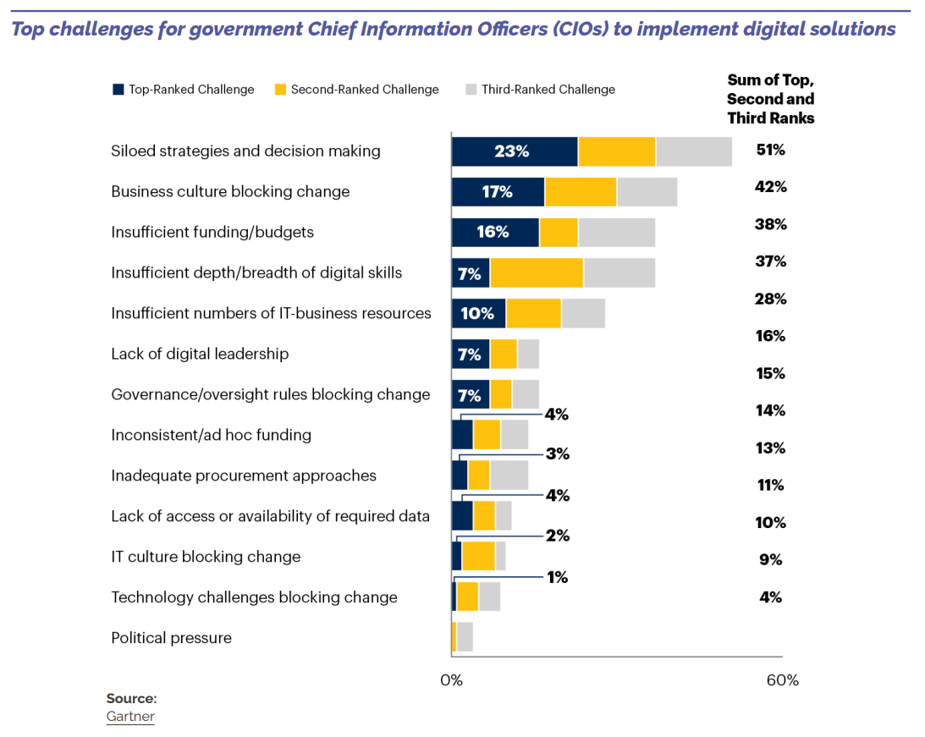
Notes:
Leadership plays a major role in achieving digital transformation projects. Indeed, the way leaders shape an environment for digital teams is essential for them to be able to follow a clear vision and goals while developing, experimenting and testing ideas for achieving them. Digital leadership is thus an incredibly important key to the success of any initiative or for the completion of digital government transformation. However, an estimated 80% of public-sector leaders say they have fallen far behind private capabilities, with only 26% having the leadership to successfully execute the digital transformation strategy
Up in the hierarchy, top-level government officials are often aware of these barriers in their organisations.
51% of government Chief Information Officers (CIOs) say that they are blocked from inspiring digital transformation by siloed strategies and decision making, amongst other difficulties
However, these are tough but not insurmountable challenges. We need to build government cultures and organisations that are built for the digital age – ones that allow experimentation, agility and encourage innovative solutions.
Leadership plays a major role in achieving digital transformation projects. Indeed, the way leaders shape an environment for digital teams is essential for them to be able to follow a clear vision and goals while developing, experimenting and testing ideas for achieving them.

Slide 9
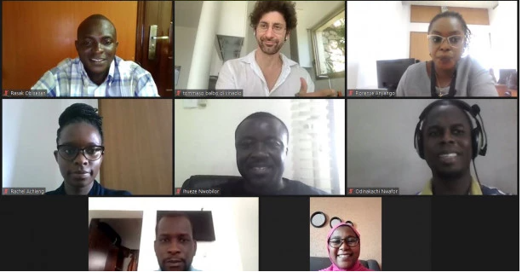
A Global and Multistakeholder Approach
Regional consultations in Asia, Africa, Latin America and the Caribbean
Global group of working group members and commissioners
Notes:
The competency framework has been developed through a multistakeholder and inclusive process. Six global and regional consultations were organized to understand the challenges of digital transformation.
Regional consultations in Asia, Africa, Latin America and the Caribbean
Global representation - working group members and commissioners. The UN Broadband Commission’s Working Group on AI Capacity Building developed the framework through extensive consultations with inter-disciplinary experts, representatives of governments, academia, civil society, the private sector and many UN -entities.

Slide 10
A focus on competencies for civil servants
Digital Planning and Design
Data Use and Governance
Digital Management and Execution
Understand complexity
Anticipate the unexpected
Recognize opportunities
Understand data
Leverage data
Manage data
Manage projects
Implement policies
Be agile and collaborative
Notes:
A focus on competencies for civil servants
Digital Planning and Design enables civil servants to understand the complexity of today’s problems, recognise strategic opportunities to use digital solutions, and envision and design inclusive digital transformation projects.
Competencies: systems thinking, problem identification and solutions, strategic foresight, agile strategy.
Data Use and Governance equips civil servants to understand and use data – its fundamental role, value, and opportunities, inherent risks. It supports civil servants to address governance challenges and manage data effectively, ethically, and responsibly.
Competencies: digital literacy, data-driven decision making, open data and open government, privacy and security, legal, regulatory, and ethical frameworks, AI fundamentals.
Digital Management and Execution empowers civil servants to understand new and innovative project-management and collaboration practices to enhance the success of digital transformation initiatives. It encourages civil servants to be agile and collaborative to make the most of the rapid improvements and innovation cycles of technology.
Competencies: people-centricity, iteration, agile execution, digital leadership

Slide 11
Digital Planning and Design
Competency areas and skills
PROBLEM IDENTIFICATION AND SOLUTIONS
SYSTEMS THINKING
STRATEGIC FORESIGHT
AGILE STRATEGY
Identify problems in which digital technology might be part of the solution.
Understand how problems are connected in systems.
Anticipate problems and unexpected circumstances.
Ability to plan initiatives while remaining flexible and adapting to unexpected circumstances.
Proficiency
Identify and specify problems where AI is important, and anticipate future technological developments of AI.
Take a holistic and long-term view, and use simple tools to anticipate, identify and solve problems.
Understand the complexity and interconnectedness of problems.
Master approaches, tools and methods to anticipate, identify and solve complex problems.
BASIC
INTERMEDIATE
ADVANCED
AI-SPECIFIC

Slide 12
Data Use and Governance
Competency areas and skills
DATA LITERACY
DATA-DRIVEN DECISION MAKING
OPEN DATA AND OPEN GOVERNMENT
PRIVACY AND SECURITY
LEGAL, REGULATORY AND ETHICAL FRAMEWORKS
AI FUNDAMENTALS
Understand emerging digital technology and its applications.
Mine,analyze and use data in the decisionmaking process of public policies.
Knowledge of potential breaches and how can they affect government and society.
Capacity to adapt and change existing legislation to emerging technologies. If needed, to create tech-friendly legislation.
Understand Al systems to a basic level.
Capacity to effectively create and use open data.
Proficiency
Create and edit digital content, exploit, analyze and share data, and develop legal frameworks and systems that take into account privacy and security.
Understand Al systems and master knowledge about the latest Al technologies.
Understand and use simple digital tools, and understand the implications of using data.
Integrate digital tools into government systems, and understand the concrete implications of using data.
BASIC
INTERMEDIATE
ADVANCED
AI-SPECIFIC

Slide 13
Digital Management and Execution
Competency areas and skills
PEOPLE-CENTRICITY
ITERATION
AGILE EXECUTION
DIGITAL LEADERSHIP
Ability to take into high consideration the user experience and needs on digital public policies and technologies.
Learn and accept mistakes as part of the digital project cycle.
Capacity to formulate technical, logistic and strategic requirements for public digital projects and execute them.
Ability to develop a vision for digital.
Proficiency
Master, design and use specific agile management techniques, forge solid partnerships, and develop prototypes.
Make use of simple agile management techniques in designing and developing projects.
Understand how to incite, organize and manage the digital transformation process.
Understand agile management techniques and collaboration.
BASIC
INTERMEDIATE
ADVANCED
AI-SPECIFIC

Slide 14
Nine Recommendations
General
Raise awareness around the competencies
Support governments in adaptation of AI and digital transformation competencies
Make learning resources and training content openly accessible
Support governments in monitoring the impact of capacity building
Foster cooperation between international, regional and national organisations
For Governments
Adopt a holistic approach towards digital transformation
Develop capacity building programs and trainings
For Academia
Establish curricula and interdisciplinary programs for digital transformation related competencies
For Private Sector
Collaborate with governments to share expertise and knowledge
Notes:
Nine Recommendations for Digital Capacity Building:
Five Recommendations for all Stakeholders
Raise awareness of artificial intelligence and digital transformation competencies - These competencies are foundational for successfully implementing digital transformation in government and creating an enabling environment for digital transformation in society through improved digital governance.
Contextualise, localise, and adapt AI and digital transformation competencies - Competencies must be contextualised, localised and adapted for their specific context, based on the analysis of capacity building needs at individual, team, department, and government levels. The proficiency levels embedded in all competencies of this competency framework can guide this contextualisation process.
Develop a diagnostic tool for all civil servants to assess AI and digital transformation-related levels of competency at individual, team, department, and government levels to enable governments to develop capacity-building programmes as per needs and context. Ensure that the tool is available as a digital public good that can be easily adapted by governments for use in different languages.
Share learning resources for AI and digital transformation capacity building - Develop open learning hubs and multi-pathway curricula tailored to the learning needs of civil servants. Facilitate their training through networks of training institutions and through various modalities of learning.
Monitor the impact of AI and digital transformation projects. - Monitor the impact of AI and digital transformation projects with qualitative and quantitative tools and in collaboration with research centres. Identify and share openly best practices.
Facilitate knowledge exchange and mutual learning through multi-lateral cooperation. - Create coalitions and platforms for exchanging good practices on AI and digital transformation-related capacity building at the national, regional, and international levels.
Four Targeted Recommendations for Governments, Academia and the Private Sector
Recommendations for Government
Take a holistic approach when using the framework. Begin by developing a national AI and digital transformation strategy, then develop digital action plans on strengthening specific competencies.
Develop a digital transformation strategy, at national level, underpinning all the digital transformation efforts the country aims to undertake;
Recommendation for Academia
Leverage the framework to establish curricula and interdisciplinary programs for developing AI and digital transformation – related competencies.
Recommendations for Private Sector
Collaborate with governments to implement capacity-building initiatives by contributing expertise and knowledge based on experience with digital transformation.

Slide 15
Thank you for your attention.
Happy to hear your questions!
Notes:
Closing

