Slide 2
Overview
Combined sentiment analysis, network theory, and data visualization in line with industry-level data science standards.
Dashboard
Network visualization
AI Assistant
Public Institutions
Notes:
Sentiment Analysis of Textual Responses: Quantified polarity and subjectivity using NLP techniques.
Co-occurrence Network Construction:
Generated nodes weighted by response frequency.
Created an adjacency matrix to model pairwise response associations.
Network Visualization with D3.js: Rendered an interactive graph to explore response patterns.
AI Assistant for guiding conclusions

Slide 3
Dashboard
Provides a broad-based tool
for high level overview.
The most chosen drivers:
Digital Diplomacy and Evolving Frameworks of International Data Governance for Data Protection/Control, Privacy Laws, Cross Border Data Flows, and Cybersecurity (12)
Growing Importance of New Cross-Border e-Commerce Legislation and Digital Taxation (11)
Decentralization of Power (10)
Public Institutions

Slide 4
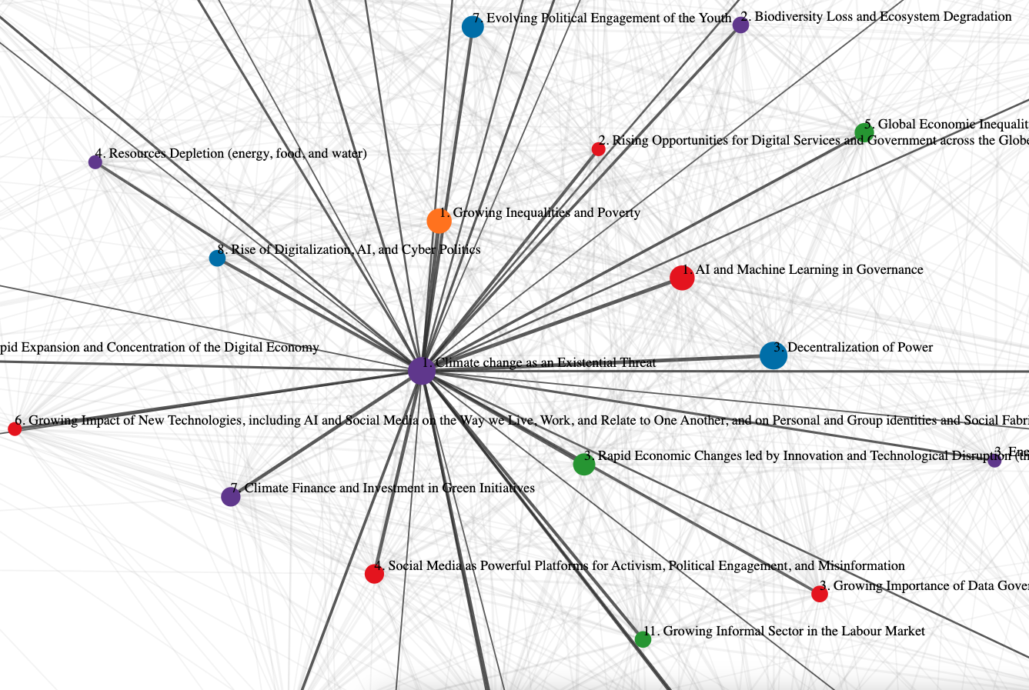
Co-occurrence Network Construction
Uses
Shows which combination of choices are made by respondents
Identifies clusters of choices
Identifies the centrality of specific choices
Identifies outliers
Public Institutions

Slide 5
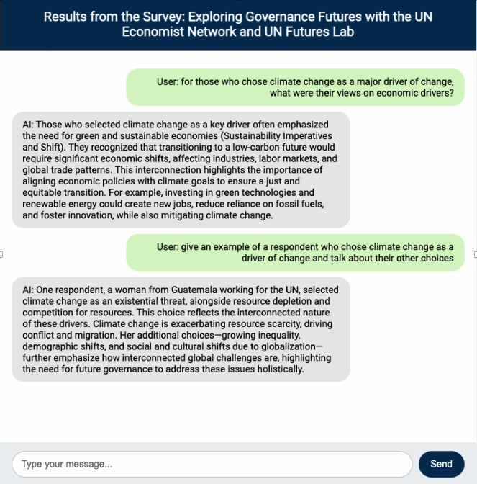
AI Assistant for guiding conclusions
Uses
Extending the conclusions of the dashboard and network graph.
Providing individual examples
Explicitly examining interconnections
Public Institutions

Slide 6
Thank you.

