Slide 1
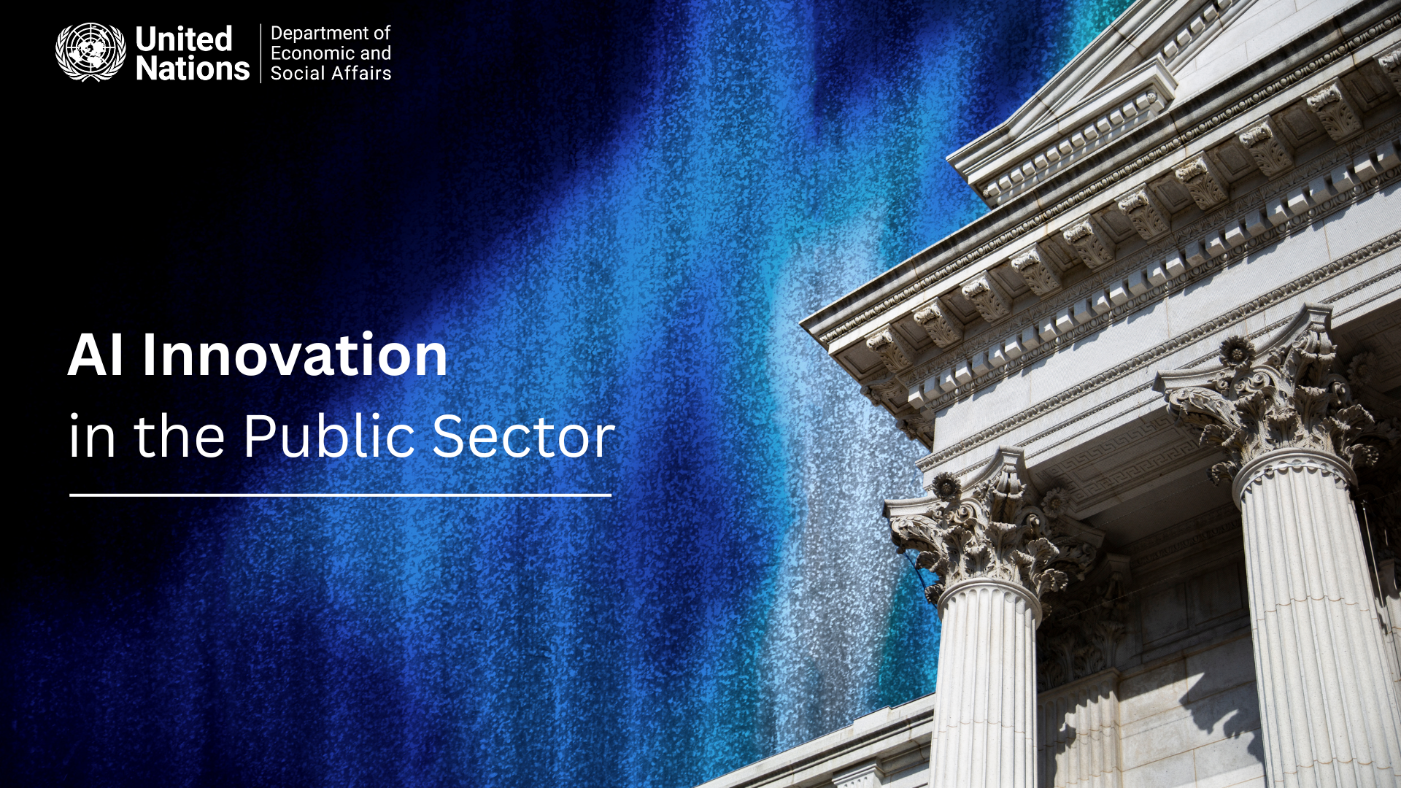
Public Institutions

Slide 2
Three Blueprints for Impact
Adaptable Case Studies in Social Services, Infrastructure, and Citizen Engagement
Public Institutions

Slide 3
AI regulation as of 2015
Current Approaches
European Union: The EU uses the binding, risk-based AI Act to protect fundamental rights, setting a comprehensive legal standard with global reach.
United States: The US prioritizes innovation and national security through voluntary frameworks (NIST AI RMF) and politically contingent Executive Orders, avoiding comprehensive legislation.
United Kingdom: The UK pursues a "pro-innovation" third way, empowering existing regulators with principles-based guidelines instead of creating a new, overarching AI law.
China: China implements targeted, binding regulations for specific AI applications to ensure state control and social stability, using tools like a mandatory algorithm registry.
Canada: Canada's proposed Artificial Intelligence and Data Act (AIDA) aims for an EU-style risk-based approach but has been stalled by criticism over its scope and development process.
Sources and related content
Public Institutions

Slide 4
Case Study #1
Reimagining Citizen Services (Canada)
Problem: Farmers struggled to find information on 400+ support programs scattered across a complex government website.
AI Solution: "AgPal Chat," a generative AI chatbot that provides conversational search.
How it Worked: The AI is "grounded" on the official website, meaning it only uses that content to provide accurate answers. It understands natural language questions, synthesizes a summary, and provides direct links to the source.
Impact & Adaptability: Gives farmers 24/7 access to vital information. It is built with privacy-by-design to protect user data. This is a highly adaptable model for any agency wanting to make its website more user-friendly.
Public Institutions

Slide 5
Case Study #2
Intelligent Infrastructure Management (Singapore)
Problem: Manual road inspections were slow, expensive, and only fixed defects after they became a problem.
AI Solution: An AI-powered "digital twin" of the road network enables predictive maintenance.
How it Worked:
Computer Vision AI analyzes video from vehicle-mounted cameras to automatically detect and map road defects like potholes and cracks.
A Predictive AI then forecasts future road decay based on defect data, traffic, and weather.
Impact & Adaptability: Shifts from reactive repairs to proactive maintenance, saving money and improving safety. The core method is adaptable using simple vehicle cameras, even smartphones.
Public Institutions

Slide 6
Case Study #3
Predictive Aid & Social Protection (Togo)
Problem: Needed to rapidly deliver COVID-19 aid to the poorest citizens without a national income database.
AI Solution: A machine learning model created a high-resolution "poverty map" using non-traditional data to predict wealth.
How it Worked: The AI analyzed satellite imagery (e.g., roofing materials) and anonymized mobile phone data (e.g., call patterns) to identify the poorest households.
Impact & Adaptability: Aid was targeted and delivered quickly via mobile money. This model is highly adaptable for Africa, leveraging widespread mobile and satellite data.
Public Institutions

