Slide 1
Multi-Stakeholder Collaboration as a Tool for Promoting Data Governance
Nagham ElHoussamy
Associate Director for Research, Middle East and Africa
Access to Knowledge for Development Center
MENA Observatory on Responsible AI
Onsi Sawiris School of Business
American University in Cairo
11 December 2024

Slide 2
What is Data Governance?
Collection
Processing
Sharing
Storage
Security

Slide 3
Notes:
Governing Responsible Data and Artificial Intelligence in the Middle East and North Africa (MENA) project, which has an overarching objective to strengthen the development, deployment and governance of responsible AI and data through knowledge creation, networking, policy and regulatory support, and interdisciplinary collaboration and capacity development. The research objective of this fieldwork is to assess the governance of health data in different healthcare settings in urban Egypt, with a focus on data on women’s health. The goal is to identify gaps and provide policy recommendations for the governance of responsible data and AI in MENA. The project is supported by Canada’s International Development Research Center (IDRC).

Slide 5
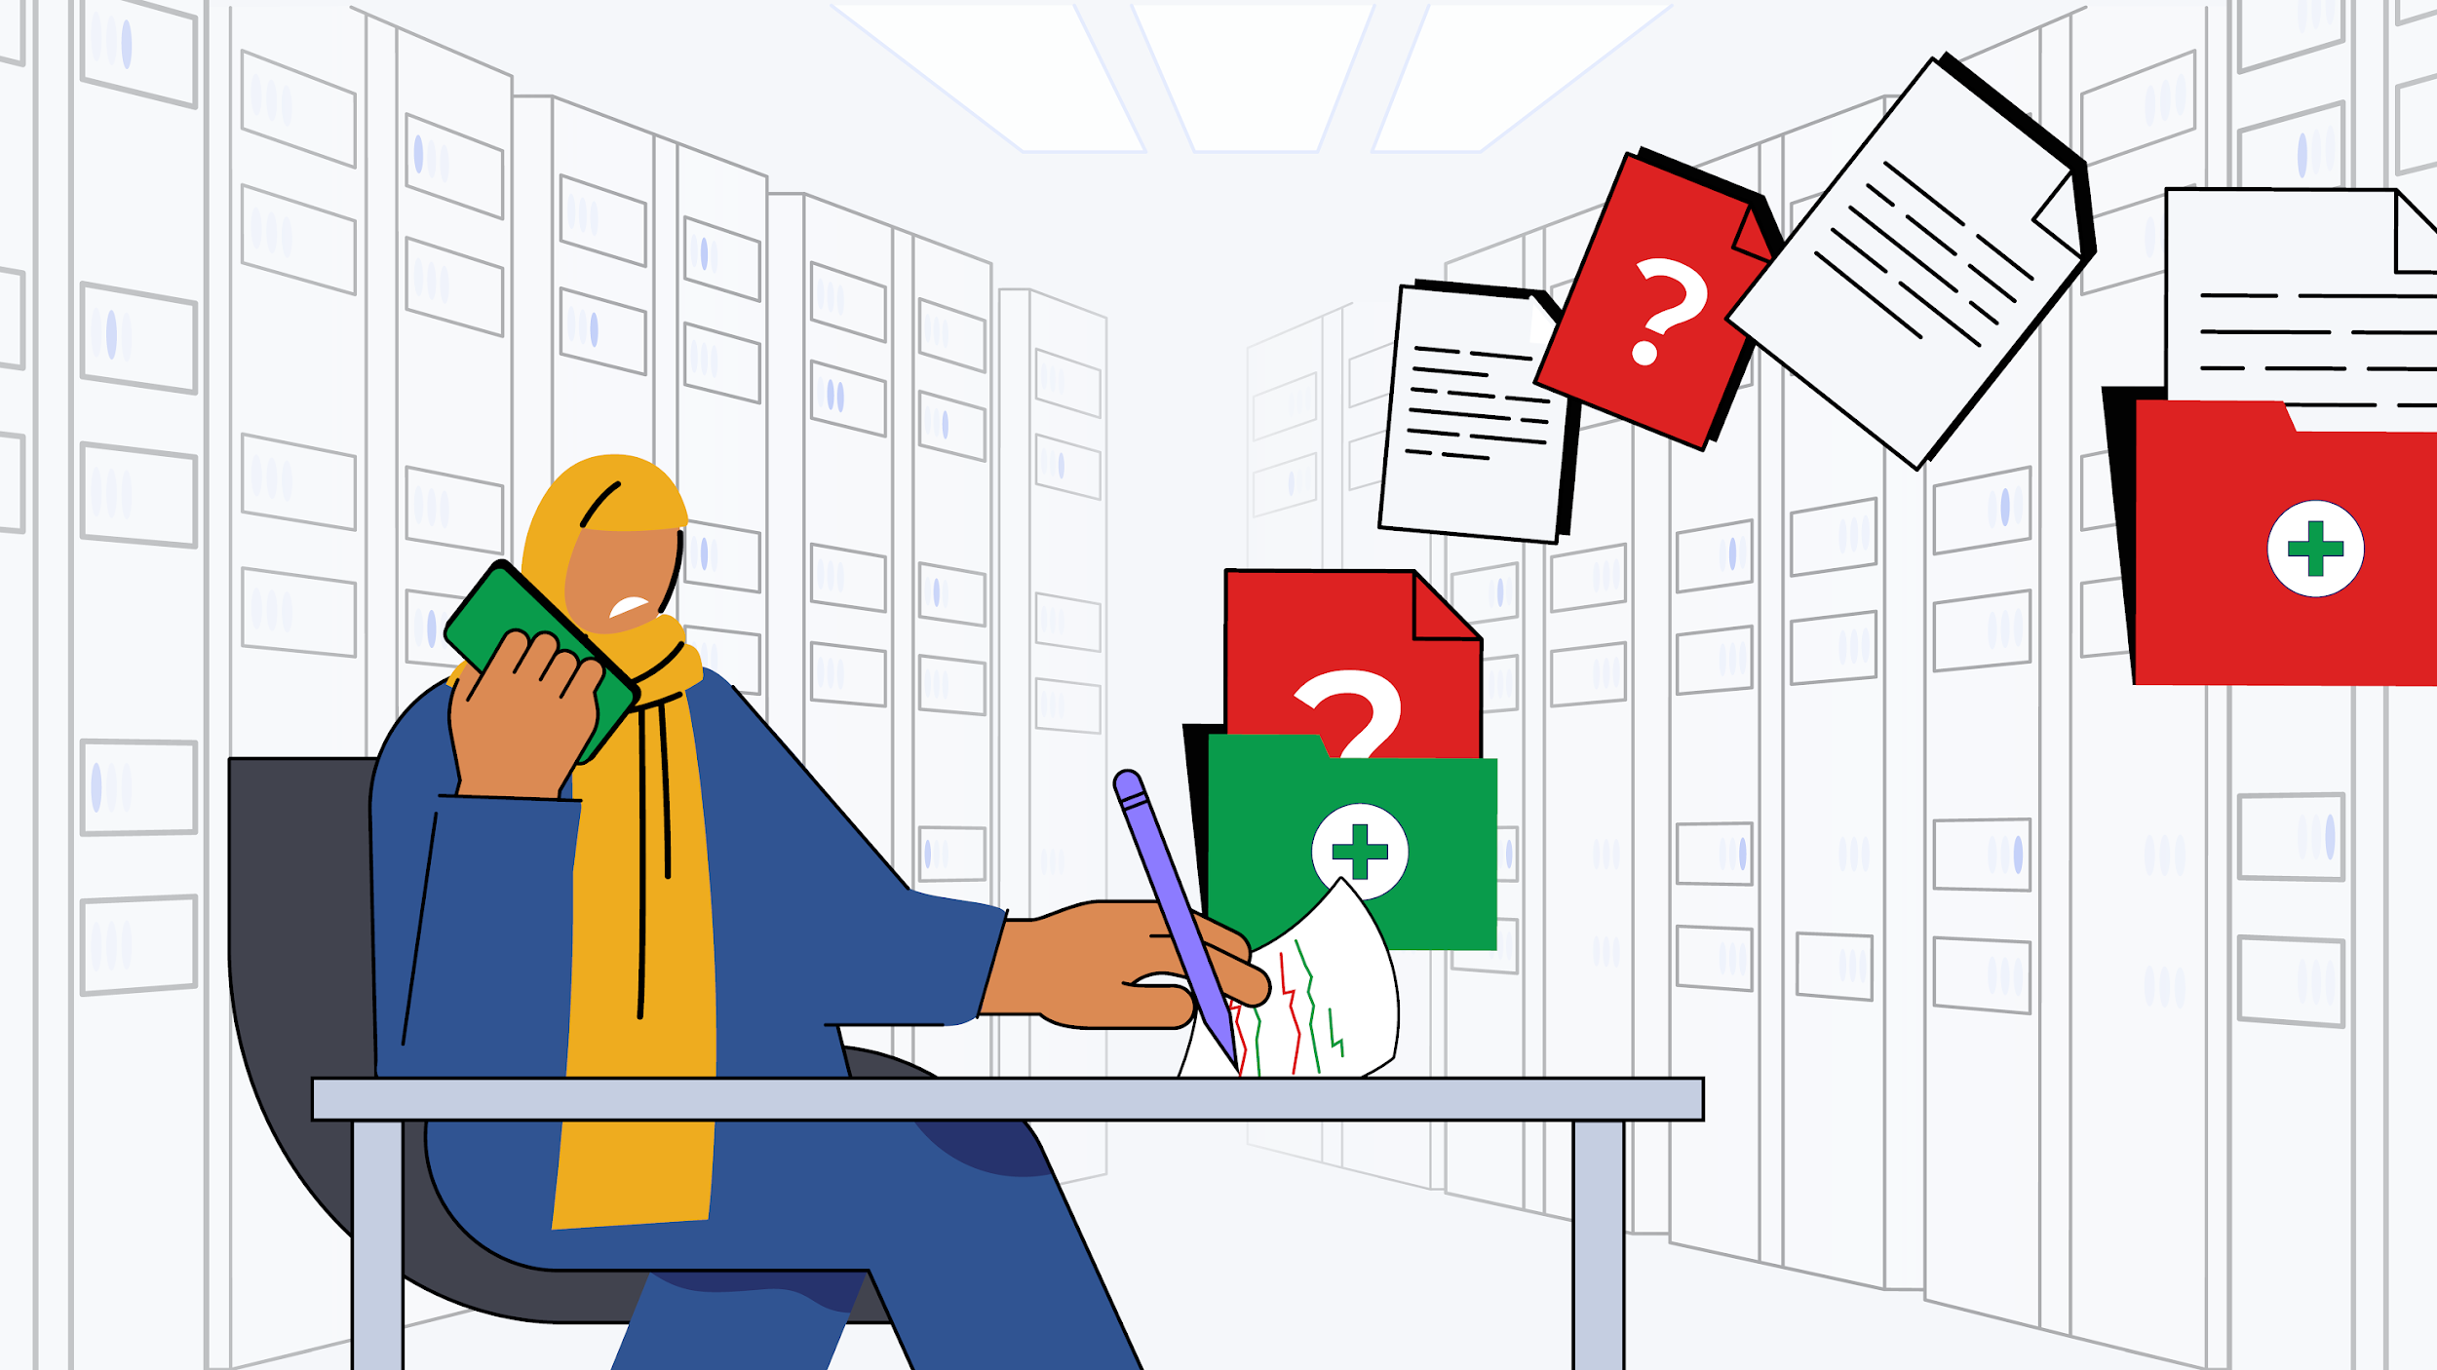
Fieldwork Insights: (1) Data Collection in PHCs
Challenges in collecting data due to cultural barriers and lack of awareness regarding the importance of data
Lack of proper data collection mechanisms
Paper-based data collection taking up physical storage space & affecting data quality due to incomplete data fields and errors
Nurses updating data manually by calling patients - no way to ensure the veracity of data retrieved from patients
Little time is spent on recording high-quality, well-organized medical reports

Slide 6
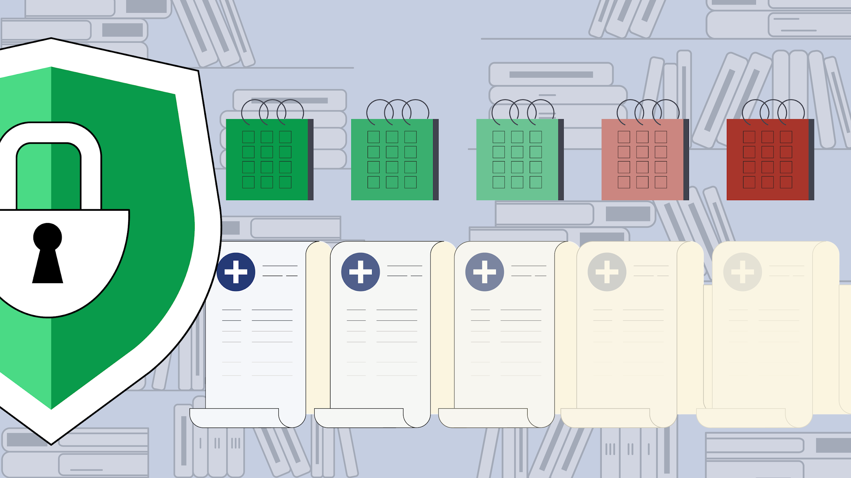
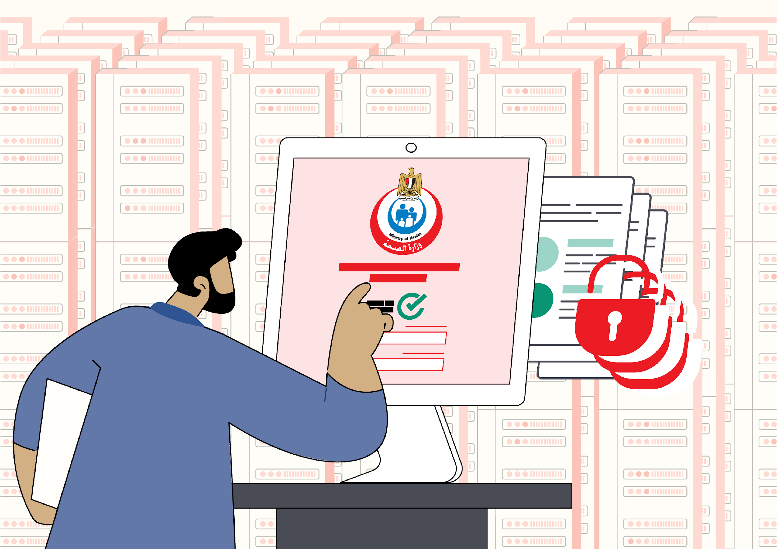
Fieldwork Insights: (2) Data Processing in PHCs
Paper-based data: Issues with translating analogue data into digital data suitable for future AI use
Issues of data quality due to incomplete data fields, data errors, manual data updates, data inaccuracy due to relying on patients' verbal information
Inability to edit data errors after patients are discharged: Nurses do not have access to the data collected on their tablets (data entry-only system)
Data is only accessed, modified, or retrieved centrally through the Ministry's Information Center

Slide 7
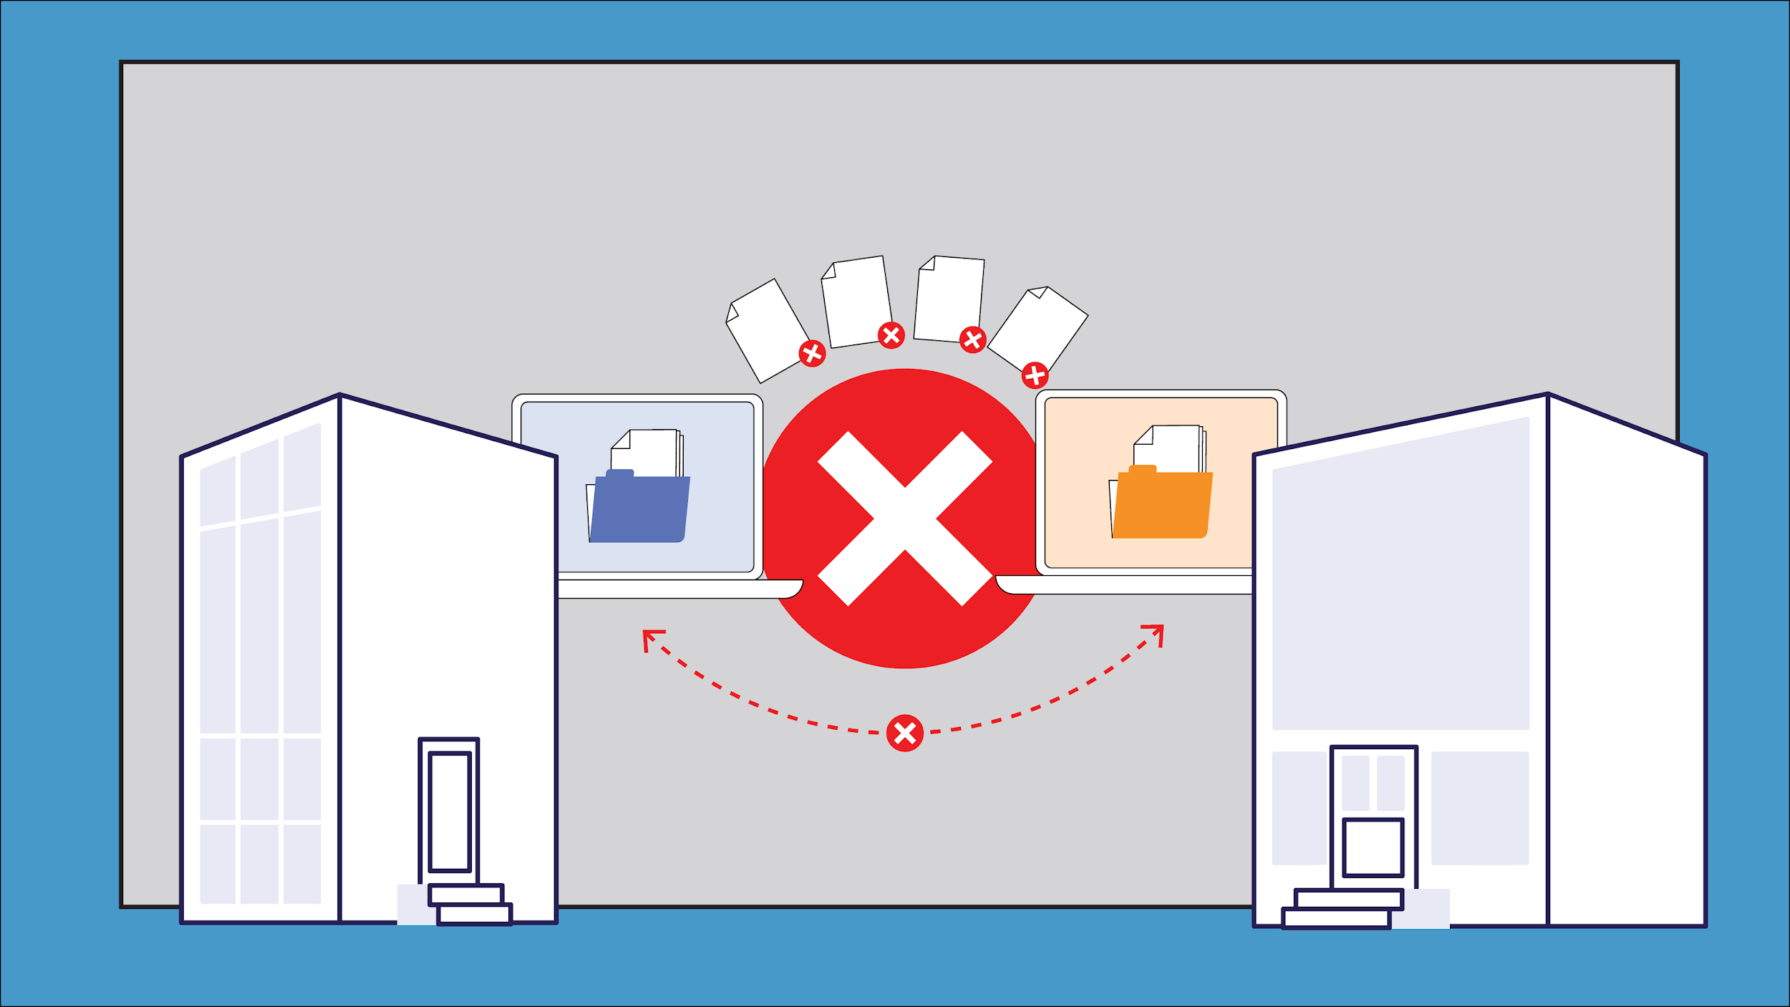
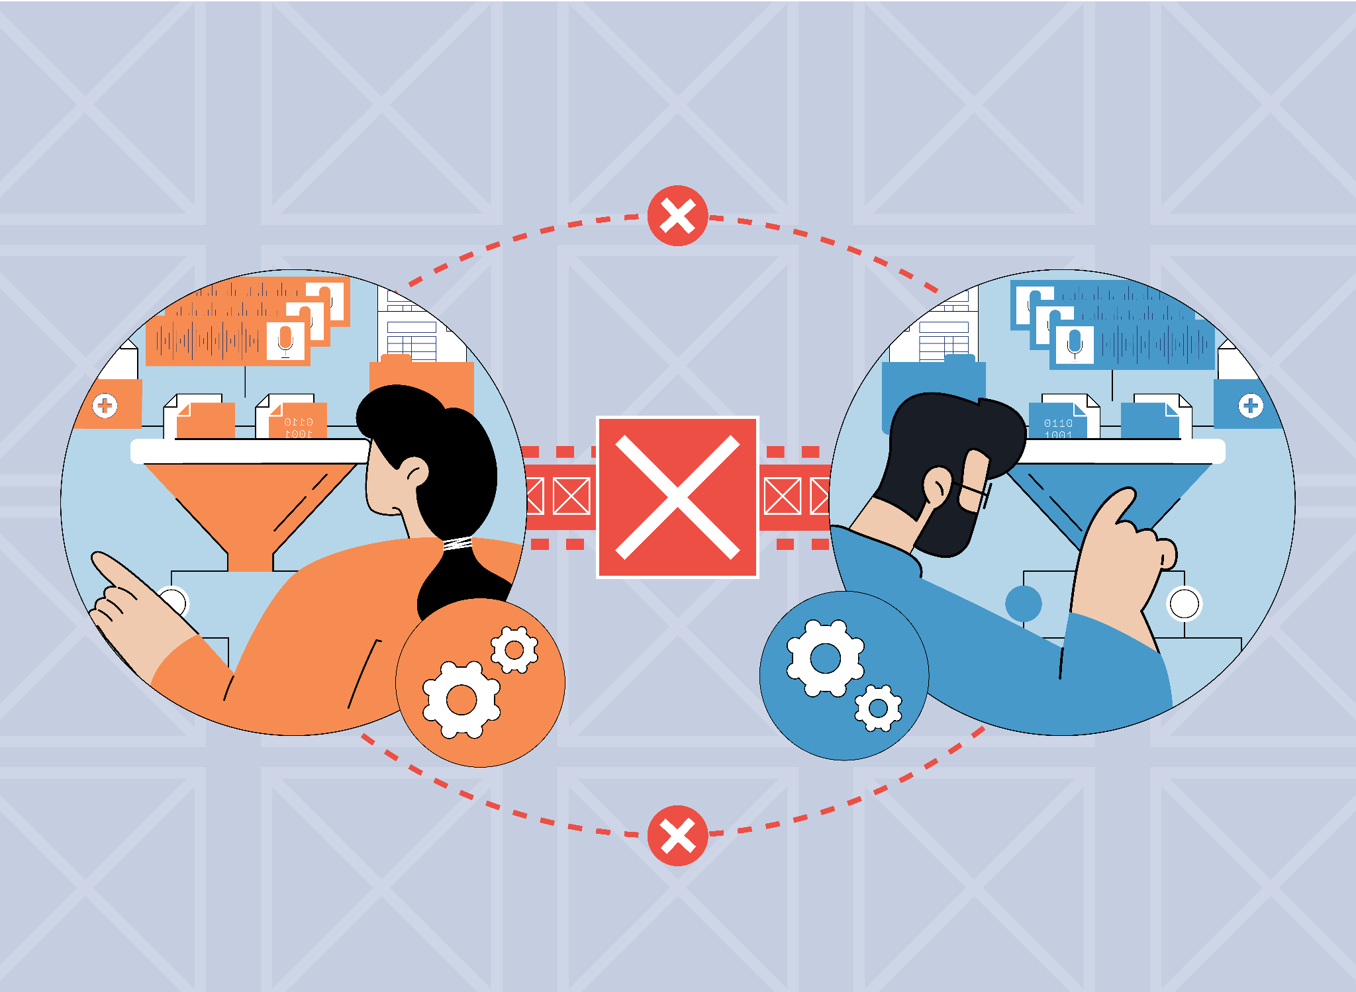
Fieldwork Insights: (3) Data Sharing in PHCs
No data sharing occurs between PHCs and other healthcare entities as the (digital) data is not stored in an interchangeable format
Data standards are not unified across healthcare providers, making data transfer and communication difficult

Slide 8
Fieldwork Insights: (4) Data Storage in PHCs
Data is stored in paper files and kept for up to 5 years
This makes it difficult to maintain the quality of the data (e.g., due to ink fading, paper decomposing, etc.)
Registers taking up a lot of physical space
Presidential initiatives’ digital data is stored on a server managed by the Ministry of Health
An IT person is in charge of keeping track of the government’s information systems, including the presidential initiatives’ data
Notes:
.

Slide 9
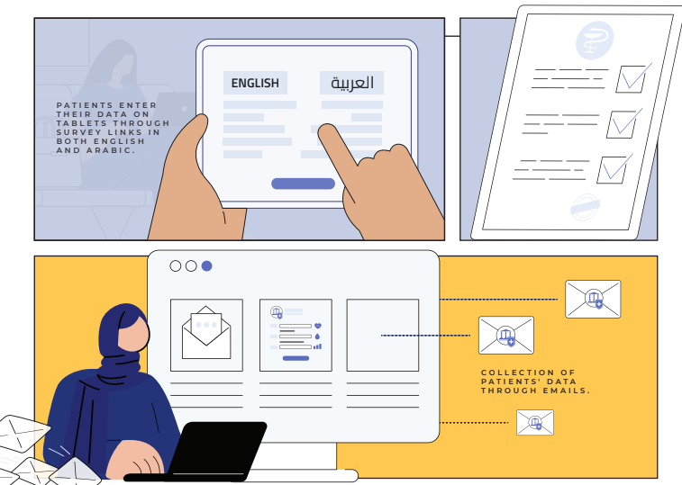
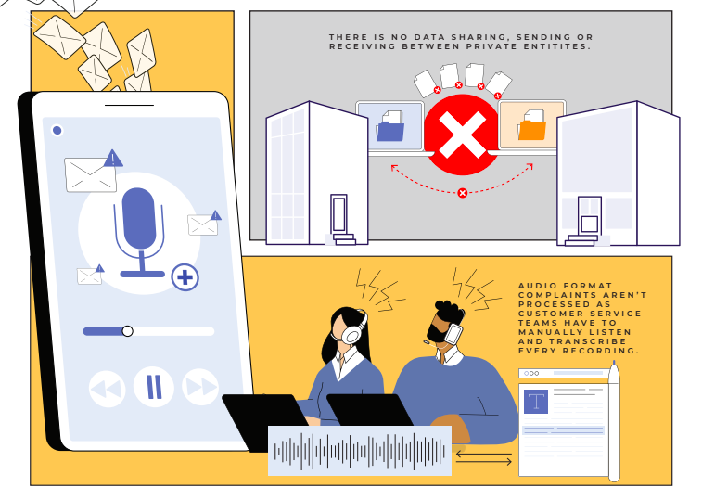
Fieldwork Insights: Private Sector
Notes:
Patients enter their data on tablets through survey links in both English and Arabic.
Collection of patients’ data through emails
No data sharing, sending or receiving between private health entities
Audio format complaints are not processed as customer service teams have to manually listen and transcribe every recording

Slide 10
Build Trust in Data Systems
Protecting Data
Maintaining Privacy
Establishing transparent and inclusive processes throughout the data cycle
Inclusive Stakeholder Engagement
Notes:
This pillar highlights the significance of implementing trust within health data governance, which can be fostered through a transparent and inclusive governance system to increase public trust. Data system trust-building encompasses many elements; protecting data, maintaining privacy, and establishing transparent and inclusive processes throughout the data lifecycle. There is a need to employ technical measures, such as encryption and two-factor authentication, to increase data security. Moreover, systems should acknowledge the data subject’s right to comprehend the purpose of data collection. By taking all of this into consideration, maintaining transparency and inclusive stakeholder engagement, and implementing mechanisms that respond to feedback and concerns over data misuse, health data governance can foster trust and uphold standards of integrity and respect for individual and collective rights.

Slide 11
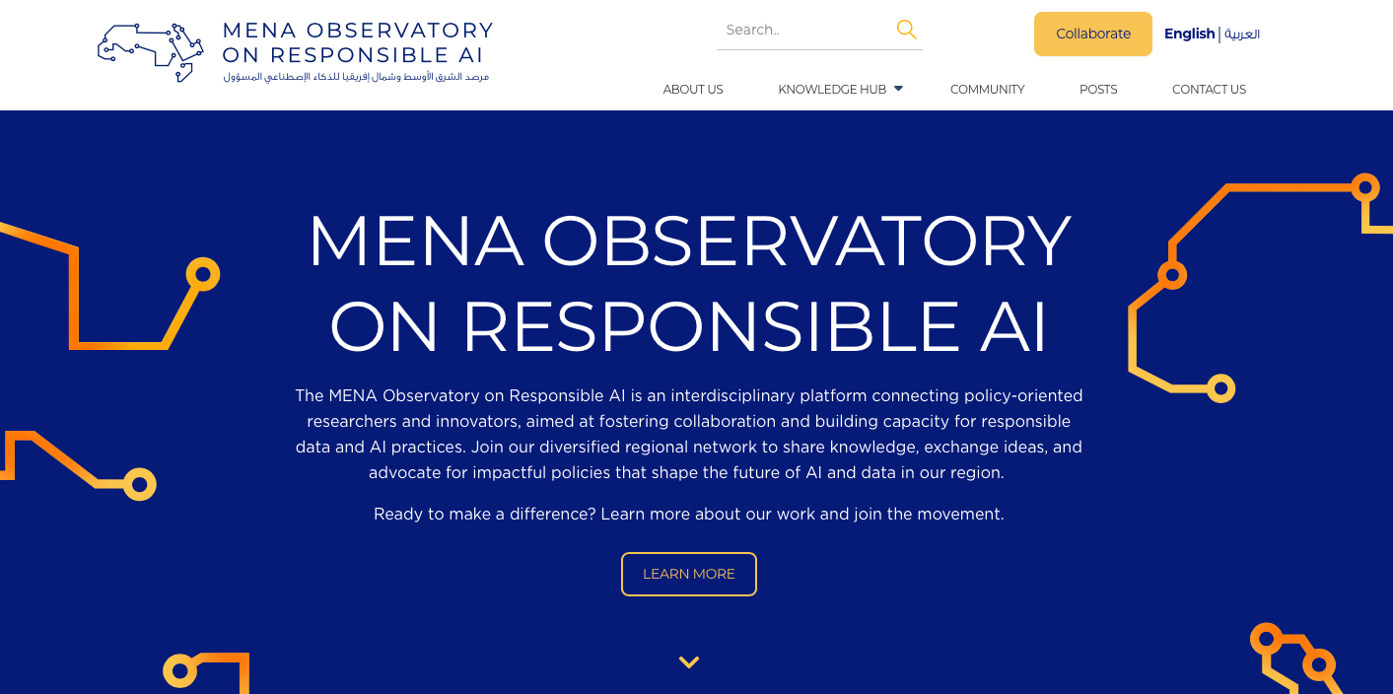
MENA Observatory on Responsible AI
Menaobservatory.ai

