Slide 1
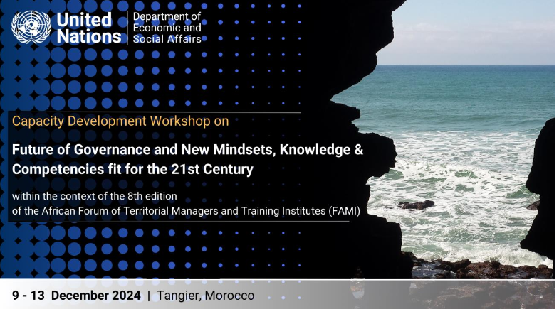
The Future of Governance and Drivers of Change in Africa

Slide 2
It is all about the people, for now or for the future
All that matters is Development
People hope for
    An ever improving quality of life and well-being
    in the context of their cultural values and beliefs system;
Who shall do so?
    It is only the people themselves who can bring about development they desire and deserve to have.

Slide 3
How do people bring about development
Set out a system by which development resources are governed
Establish an institution designated as ‘government
Organise the institution into three major offices of
    legislating,
    executing, and
    interpreting laws

Slide 4


Government—Governance?
Governance
  constitutional methods and approaches; systems and processes; acts, practices and interactions that
  the people adopt and entrust the government with
      legislative, judicial, and executive authorities
      goals and objectives of ensuring an increasing quality life of the people
Government
    an institution with legislative, judicial, and executive authorities to regulate and ensure an increasing quality of life of the people

Slide 5
Governance in Africa: Current Context
  expanding security crisis; and
  shrinking participatory environment;
  escalating conflicts; and
  deepening mistrust in democratic institutions
Overall governance in Africa measures ‘sobering’

Slide 6
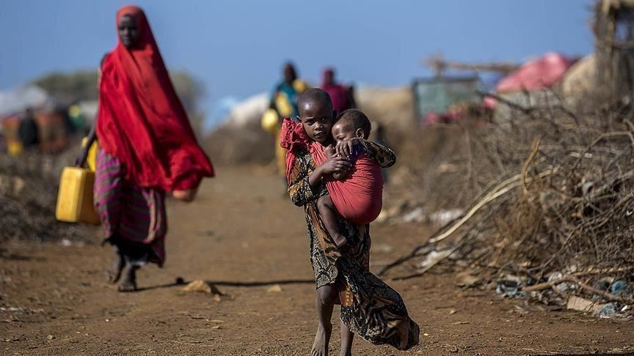
The African Continental Paradox
Pervasive Poverty
Abundant Resource
Endowment
Rich in Agricultural Resources
Rich in Energy Resources
Rich in Financial Resources
High Levels of Food Insecurity
Deficits in Access to Electricity
Debt Distress

Slide 7
What needs to be done?
Mobilise domestic resources
A holistic and integrated approach in Governance
underpinned by strong institutions as cross-cutting enablers, and
facilitated by digitization and deployment of technological solutions.

Slide 8
Government institutions had failed to effectively facilitate the people with the means and instruments that may support the people work to achieve SDGs:
Africa remains off-track in attaining the SDGs.
Why?
  with accountability and inclusiveness,
  based on the people cultural values and beliefs; ideas and understandings
  to serve and operate within formal rules and structural settings the people have adopted

Slide 9
Drivers of Change:
Focuses on the institutional and structural factors affecting government competence, policy coherence, and collaborations.
Bases conceptual models of structures, public servants, and mediating institutions.
Emphasises on how to effect change in government
Approach addressing the lack of linkages between
  National development frameworks and
  Operations of government institutions
to ensure an sustainable improvement in the quality life of the people—Sustainable Development

Slide 10
Analysing Drivers of Change: External and Internal Perspectives
External Forces of Change:
Majour factors influencing the need for change from outside
Includes:
  social demographic,
  political, economic, legal
  technological, cultural;
  business management.
Internal Forces of Change:
Majour factors influencing the need for change from within.
Comprises government institutional:
  strategy, mission, and mandate;
  structure and process;
  values and beliefs;
  knowledge and understandings.

Slide 11
Governance Africa: Drivers of Change

Slide 12
Thank you
Merci
iشكرًا
Asante
,

