Slide 1
Name: Augustus Jonathan Flomo
Title: Deputy Minister for Economic Management
Ministry of Finance and Development Planning
Country: Liberia
APRM- DESA Continental Workshop
Strengthening Institutional Capacities in Africa for Effective Implementation of the 2030 Agenda and Agenda 2063: Follow-up to the 2023 SDG Summit
26-28 October 2023 – Cape Town

Slide 2
Session 7:
TOWARDS INTEGRATED NATIONAL INSTITUTION-BUILDING STRATEGIES THAT ADDRESS IMPORTANT CAPABILITY GAPS ACROSS THE WHOLE OF GOVERNMENT

Slide 3
We are all aware that the world is severely off track at halfway mark of the Sustainable Development Goals (SDGs); same applies to the Agenda 2063. Liberia is off track as well. The UN Secretary-General letter of 3 April urged world leaders to help deliver an ‘actionable and doable Plan for People and Planet at this year’s SDG Summit. Reflecting on the above, it is important to note that these global engagements around the ambition of the SDGs and the Agenda 2063 will continue to push member states to do all they can to get on track with the implementation of critical targets between now and end of 2030 while working to ensure the Agenda 2063 gets on track to meet its goals by 2063 as well.
In this light, we see some critical Strategic Capacity challenges faced by Governments and Institutions which can be summarized as follow:
Limited Domestic Resource Mobilization programs
Limited Public-Private Partnerships (PPPs) in countries
Poor International / Development Cooperation management
Untapped Diaspora Resources
Limited Innovative Financing Mechanisms and Fiscal Management
Not Building Resilience and Sustainability within the national development initiatives
Introduction

Slide 4
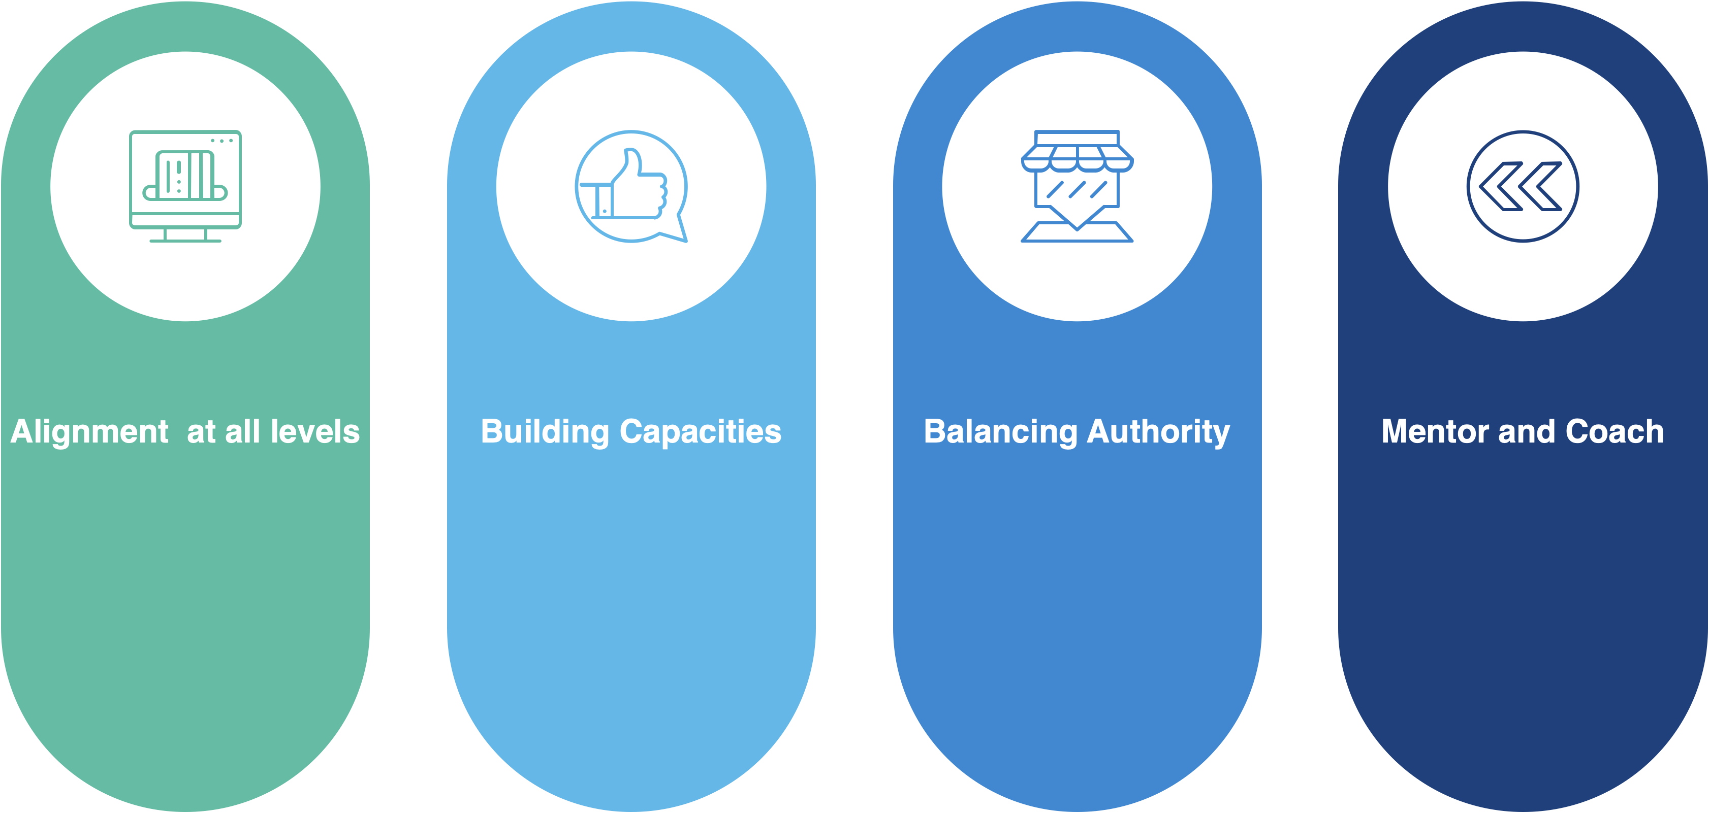
Focusing on Strategic Capacity Improvement in Governments to solve problems
Getting the Job Done
All team across the government must be prepared to think and act alike (alignment with both Government and international goals , aligning processes with key goals and results intended – ensuring the citizens are the key beneficiaries of all policies (Purpose alignment-Structure alignment- Process alignment – these will promote strategic capacity and improve institutional performance
Looking at individual capacities and cross validating in the entire Government to ensure institutional capacities are built with strong consideration of the individual abilities
Balancing authority / power with technical capabilities
Continued review of progress and taking actions on identified gaps immediately – hands on visual capacity development – coaching, mentoring, study tours (south – south relationships building and learning centers)

Slide 5
Focusing on Strategic Capacity Improvement in Governments to solve problems
Getting the Job Done
Creating the enabling environment and condition for innovation to take place at the workplace
Effective and responsive - response mechanism across the entire Government with a strong coordination mechanism with stakeholders including Development Partners
Building better salaries and incentives to attract and keep qualify and competent staff to increase productivity – results-based teams
Minimizing traditional hierarchical and entrenched bureaucratic processes at institutions
Focusing on public service as a product – to deliver for the people…
Focusing on Data and analysis for easy tracking and reporting

Slide 6
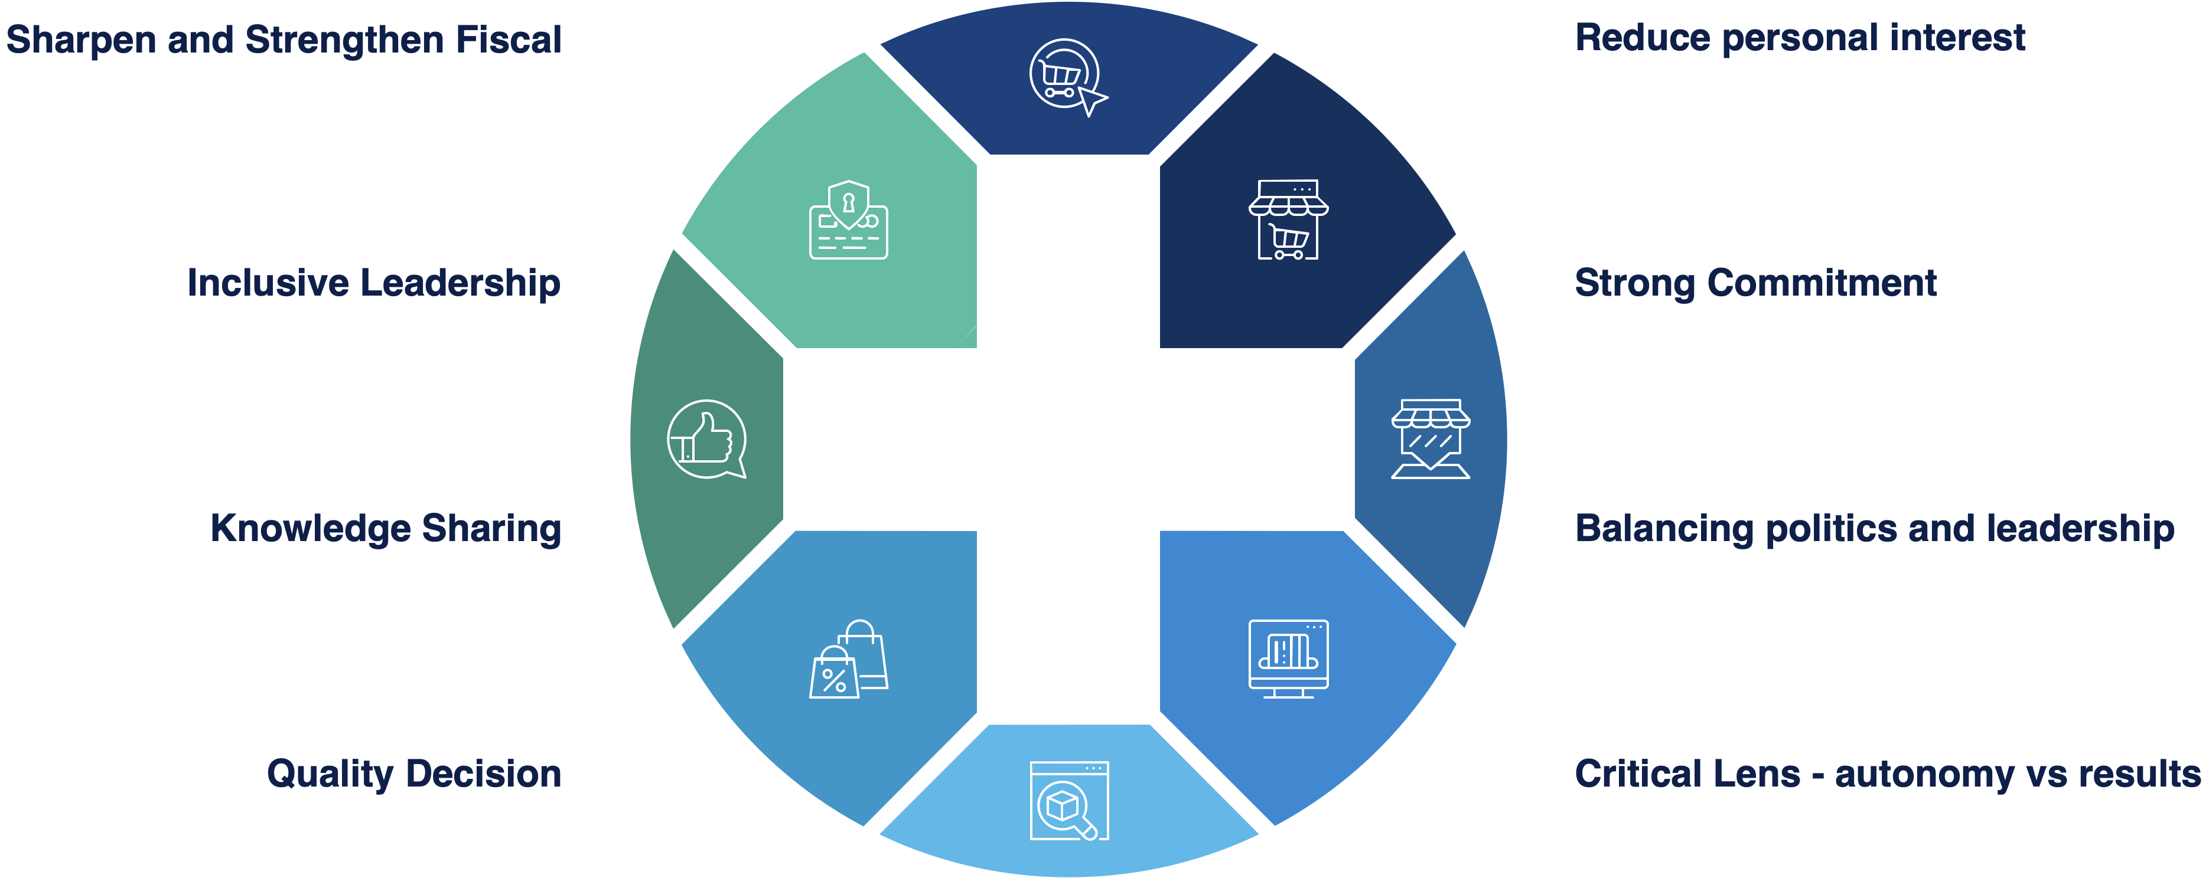
Strategic Policies Development and Mainstreaming Capacity in Institutions
Reforming as the center for sustaining Capacity – Expanding the Scope
Sharpen and strengthen fiscal policy, regulation, and enforce implementation
Practical and inclusive leadership aimed at building a sustainable system instead of just individual loyalty to particular people
Creating and sharing knowledge to increase results – governmentwide
Promoting quality decision making processes
Reduce conflict of interest concerns in the institution
Ensure strong commitments in implementing policies and programs are enhanced and sustained
Creating a fair balance between politics administration /management/system
Balancing autonomy with collective Results framework in all policies design

