Slide 1
GREEN PUPLIC PROCUREMENT (GPP)
SYLVIA KURGAT, MBA, MCIPS,PMP

Slide 2
GREEN PUBLIC PROCUREMENT
Green procurement = Environmentally Preferable Purchasing (EPP), or Environmentally Responsible Purchasing (ERP) or Affirmative Procurement (AP).
GPP entails purchasing of goods, services and infrastructure in a manner that maximizes value-for-money across the lifecycle.
GPP is strategic driver for socio-economic growth and environmental sustainability that requires public entities to maximize positive impacts while minimizing negative impacts in the lifecycle of goods, services and infrastructure.
Notes:
Aims for GPP
To minimise negative impacts of goods, works or services across their lifecycle and through the supply chain
To minimise demand for non-renewable resources
To ensure that fair contract prices and terms are applied and respected
To promote diversity and equality throughout the supply chain

Slide 3
PUBLIC PROCUREMENT AND AGENDA 2030 SDGs
Strategic use of public procurement is recognized as key to the global effort for sustainability, important enough to have a specific target and inclusion in the 2030 Agenda for Sustainable Development, SDG target 12.7: “Promote public procurement practices that are sustainable, in accordance with national policies and priorities”. Source: UNEP

Slide 4
THE CASE FOR GREEN PROCUREMENT
Economic Multipliers
Provides incentives for innovation
Cost management and budgetary control
Social Multipliers
Generates employment opportunities
Environmental Multipliers
Reduces GHG emissions
Promotes efficient use of resources
Regional economic development
Avoids disruptions in supply chain
Small and medium-sized business development
Improves OHS compliance
Improves product sustainability
Promotes fair and ethical trading
Improves supplier engagement practices
Reduces waste generation (4R Concept)
Promotes sustainable and reliable operations
Promotes inputs to specification and design of products and services
Reputational risk management

Slide 5
KEY ELEMENTS OF RESPONSIBLE PURCHASING
Responsible Purchasing
Support for small and medium scale entrepreneurs
Supplier/ Vendor engagement and accountability
Clear and timely communication
Clear lead times and payments
Respect for labor rights and human rights in the supply chain
Sustainable pricing
Leasing arrangements
Off-setting arrangements

Slide 6
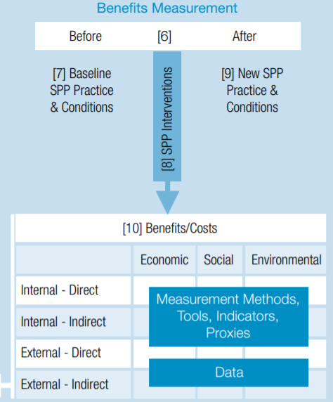
MEASURING IMPACT OF GPP
Recognizing the importance of procurement in reducing the largest sustainability impacts associated with public corporations, requires that GPP programs are appropriately implemented, and impacts routinely measured.
Source: UNEP Report, Baseline Review and development of a Guidance Framework

Slide 7
MANAGING WAIVERS AND EXCEPTIONS IN GPP CONTEXT
Buyers are guided to evaluate goods, services and infrastructure based on price, characteristics, and performance, and then to select the what is best suited to specifications. As a rule of thumb, buyers should be required to select GPP-designated goods, services and infrastructure.
Where non-compliant goods, services and infrastructure is preferred or selected, an exemption or waiver document should be raised and approved primarily based on cost, availability or delivery timeliness. Thresholds should be established to guarantee consistent application.

Slide 8
GPP CHALLENGES AND OPPORTUNTIES – KENYA CONTEXT
CHALLENGES
OPPORTUNITIES
Public procurement represent 10% [$10.1 Billion] of Kenya’s GDP
Under-developed legal framework for GPP uptake
Capacity constraints
High product costs
Establish and mandate GPP policies and priorities for State-Owned Enterprises
Extend GPP requirements to Infrastructure projects
GPP capacity development for public procurers and suppliers
Establish synergies between GPP and the Green Credit Financing.

Slide 9
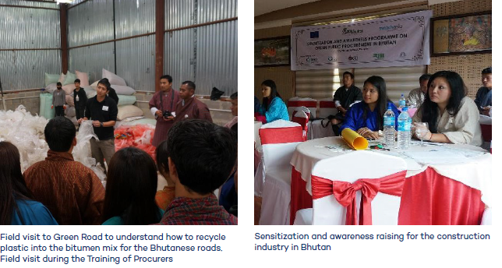
CASE STUDY - GPP Implementation in Bhutan
Source: IISD, September 2017

